Slide 1

Securing the Digital Lifeline
Firmware Integrity, Supply Chain Risk and Penetration Testing in Next Generation Medical Devices
A A I Nethmika
IT23209534
Notes:
Hello, I am Aluthwala Acharige Isindu Nethmika from SLIIT. This talk explains how to keep modern medical devices secure. I will focus on firmware integrity, software supply chain risk, and penetration testing.

Slide 2

Why this matters
IoMT improves monitoring and personalization but widens attack surface.
Cybersecurity and patient safety are tightly linked
Stakeholders : manufactures, hospitals, regulators, patients
Notes:
Medical devices now connect through the Internet of Medical Things. This improves monitoring and personalization, but it also increases the attack surface. Cybersecurity and patient safety move together. Manufacturers, hospitals, regulators, and patients are all stakeholders.

Slide 3

Aim & Research Questions
Aim: synthesize IEEE literature on firmware integrity, supply-chain risk, and penetration testing.
RQ1: techniques to assure firmware integrity and authenticity.
RQ2: frameworks to reduce software supply-chain risk.
RQ3: how to scope penetration testing to protect safety-critical functions.
Notes:
The goal of this review is to organize what recent studies say about device security. I ask three questions. First, which techniques protect firmware integrity across the device life cycle. Second, which frameworks reduce software supply chain risk. Third, how to run penetration testing in ways that protect safety critical functions.

Slide 4

Firmware integrity - key points
Secure/measured boot; authenticated software loading.
Signed over-the-air updates; rollback protection; managed keys.
Formal methods to expose defects early; lessons from failure data.
Legacy constraints → compensating measures and monitoring.
Notes:
Firmware integrity begins with secure or measured boot and authenticated software loading. Devices need signed updates delivered over the air with rollback protection and sound key management. Formal methods help find defects early. Real world failure reports show why these controls matter. Long lived or legacy devices may need runtime monitoring and other compensating measures.

Slide 5

Supply-chain risk & SBOM
Third-party libraries, COTS radios/protocol stacks, long-lived platforms.
SBOM enables fast impact analysis when CVEs land.
Authenticated, traceable updates are increasingly expected.
Notes:
Modern devices mix vendor code, third party libraries, and commercial radio stacks. This creates dependency risk across the life cycle. A software bill of materials helps teams see which components are present on a device. When a new vulnerability is published, the bill lets you check impact quickly and plan maintenance. Many standards now expect authenticated and traceable updates.

Slide 6
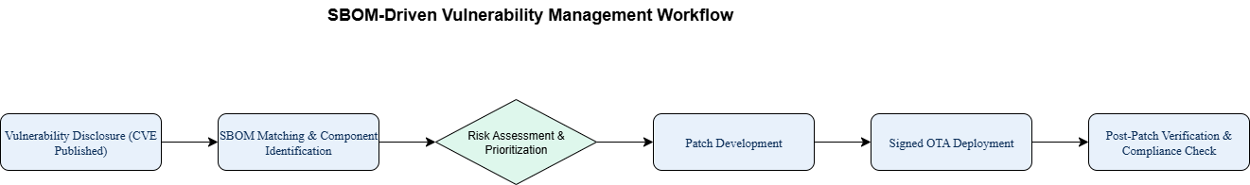
SBOM-driven vulnerability management
Notes:
Here is the workflow that uses a software bill of materials. A vulnerability is published as a CVE. We match it against the bill to find affected models and components. We assess risk and set priorities based on severity, exploitability, and patient safety. Engineering builds a patch and delivers a signed update over the air. We verify the result and keep an audit log for compliance.

Slide 7

: Penetration testing — lessons
Classic demonstrations on pacemakers/ICDs and insulin pumps showed RF misuse is feasible (under lab controls).
What to test: access control, pairing/authentication, command integrity—safely.
Adjunct protections: external anomaly monitors; auxiliary physical channels.
Notes:
Penetration testing must be careful and safe. Classic studies showed that wireless links can be misused in lab settings. We test access control, pairing and authentication, and command integrity. We use benches, emulation, or monitored radio spaces so no patient is at risk. External anomaly monitors and auxiliary physical channels can add protection during and after testing.

Slide 8

Future research
Verifiable update pipelines on constrained devices.
Lightweight attestation with safe clinical overrides.
Automated SBOM + real-time CVE matching for fleets.
Hardening patterns for legacy deployments; runtime monitors.
Bench-safe, standardized penetration testing tied to clinical impact.
Notes:
Future work should make update pipelines verifiable on resource constrained devices. We need lightweight attestation that still allows emergency access in clinical care. We need automated bills and real time matching with new vulnerabilities for large fleets. Legacy devices need hardening patterns and practical runtime monitors. We should agree on safe and repeatable penetration testing methods that map to clinical impact.

Slide 9

Conclusion
Resilience rests on firmware integrity, supply-chain visibility, and safety-aware penetration testing.
Assurance must be end-to-end across device → gateway → cloud.
Connect update integrity, SBOM-driven triage, and tested mitigations to protect patient safety.
Notes:
Three ideas hold the solution together. Protect firmware integrity. Gain visibility into the software supply chain. Use safety aware penetration testing. Assurance must cover device, gateway, and cloud in an end to end way. Connect update integrity, bill driven triage, and tested mitigations to protect patients.

Slide 10
Thank you
Notes:
Thank you for your attention.

